Slide 1

1 Factory 1 Warehouse Supply Chain Inventory Optimization via Soft Actor-Critic
By Dongzuo Tian &
Daniel Viassolo

Slide 2



Supply Chain Network
Single factory
Multiple warehouses (K in total)
Demand unknown for the current time
Stocks at both factory and warehouses
Policy to determine the total production number and distribution number to each warehouses to enlarge the reward
Warehouse
Factory
Warehouse
Warehouse

Slide 3
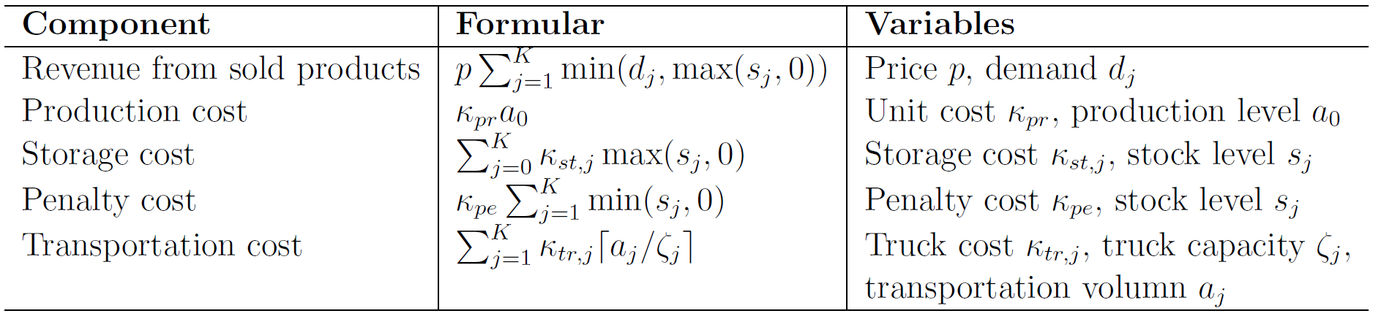
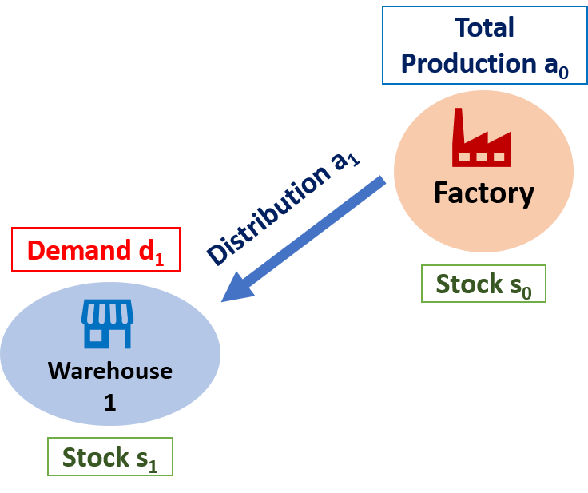
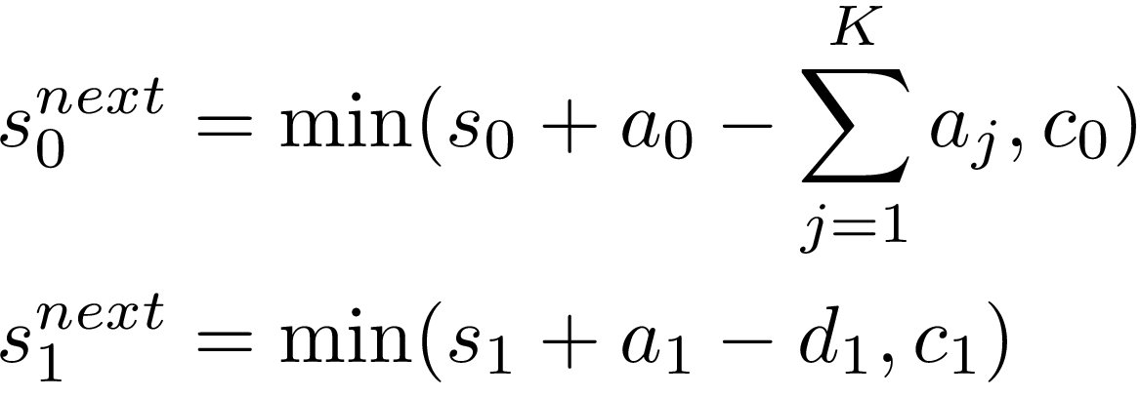
One-step Reward & State Transition
One-step reward:
State transition:

Slide 4

Reinforcement Learning Structure
State:
Action:
Knowledge of demand history
Network structure in the next slide

Slide 5
Actor-Critic Network
We adopt Soft Actor-Critic (SAC) as the actor-critic algorithm
Include target network and replay buffer tricks

Slide 6
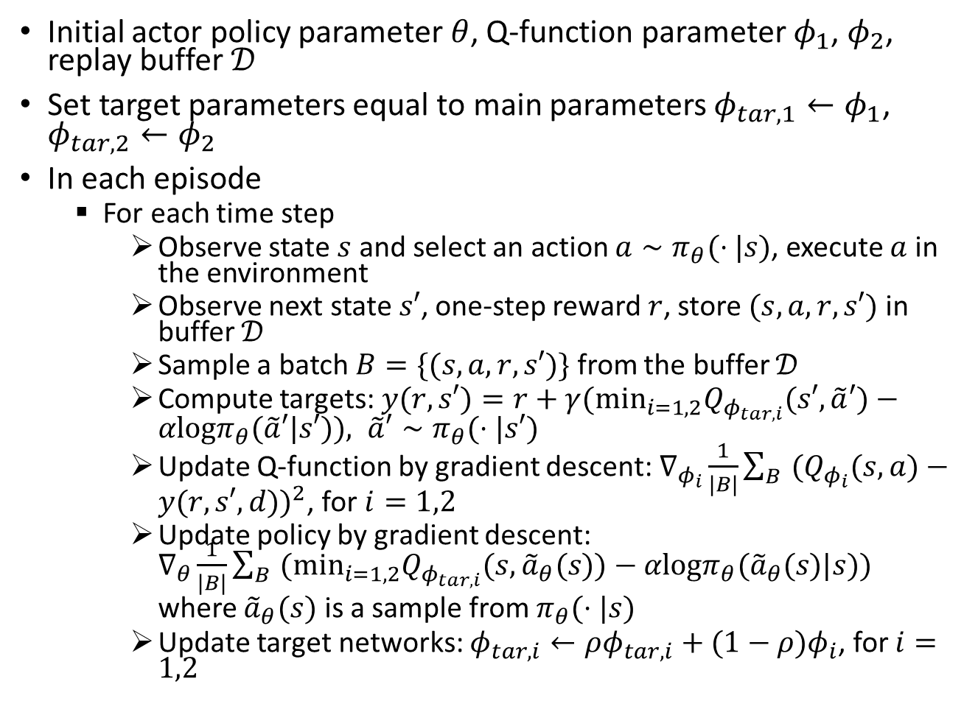
Pseudocode: Soft Actor-Critic
Initial actor policy parameter $θ$, Q-function parameter $φ_{1}$, $φ_{2}$, replay buffer $𝒟$
Set target parameters equal to main parameters $φ_{tar,1}←φ_{1}$, $φ_{tar,2}←φ_{2}$
In each episode
For each time step
Observe state $s$ and select an action $a∼π_{θ}(⋅|s)$, execute $a$ in the environment
Observe next state $s′$, one-step reward $r$, store $(s,a,r,s′)$ in buffer $𝒟$
Sample a batch $B=\{(s,a,r,s′)\}$ from the buffer $𝒟$
Compute targets: $y(r,s′)=r+γ(\min_{i=1,2}Q_{φ_{tar,i}}(s′,\tilde{a}′)−αlogπ_{θ}(\tilde{a}′|s′)), \tilde{a}′∼π_{θ}(⋅|s′)$
Update Q-function by gradient descent: $∇_{φ_{i}}\frac{1}{|B|}\sum_{B}{‍}(Q_{φ_{i}}(s,a)−y(r,s′,d))^{2}$, for $i=1,2$
Update policy by gradient descent: $∇_{θ}\frac{1}{|B|}\sum_{B}{‍}(\min_{i=1,2}Q_{φ_{tar,i}}(s,{\tilde{a}}_{θ}(s))−αlogπ_{θ}({\tilde{a}}_{θ}(s)|s))$
where ${\tilde{a}}_{θ}(s)$ is a sample from $π_{θ}(⋅|s)$
Update target networks: $φ_{tar,i}←ρφ_{tar,i}+(1−ρ)φ_{i}$, for $i=1,2$

Slide 7
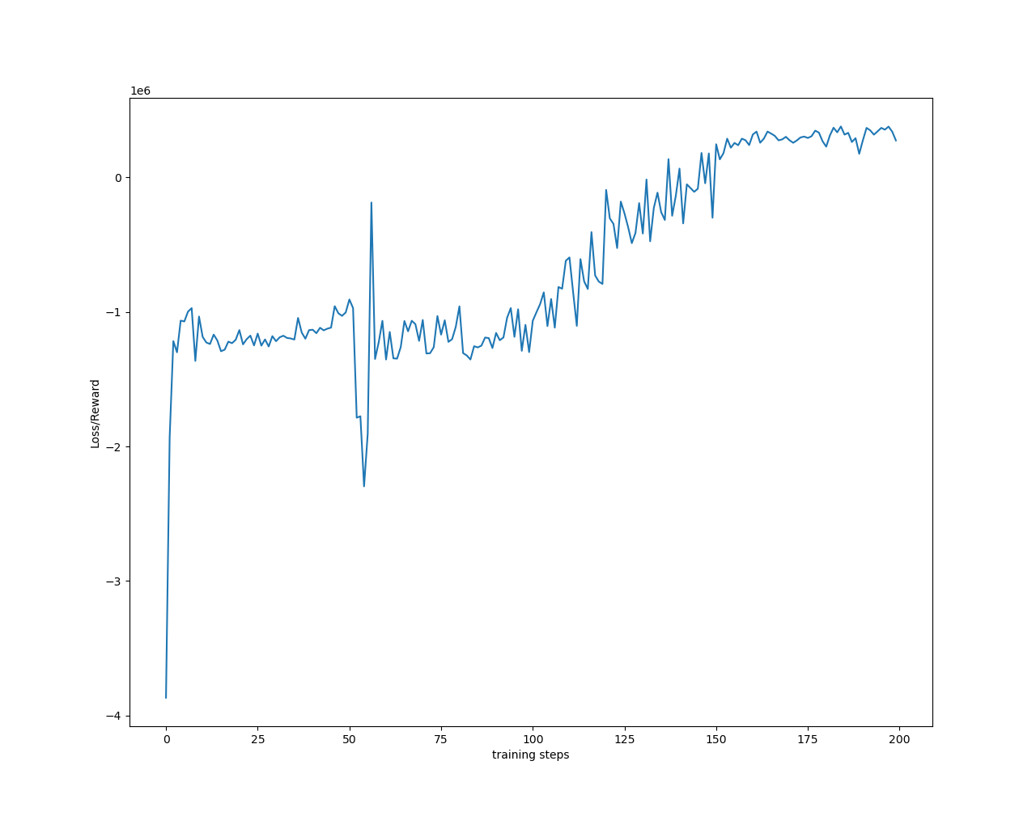
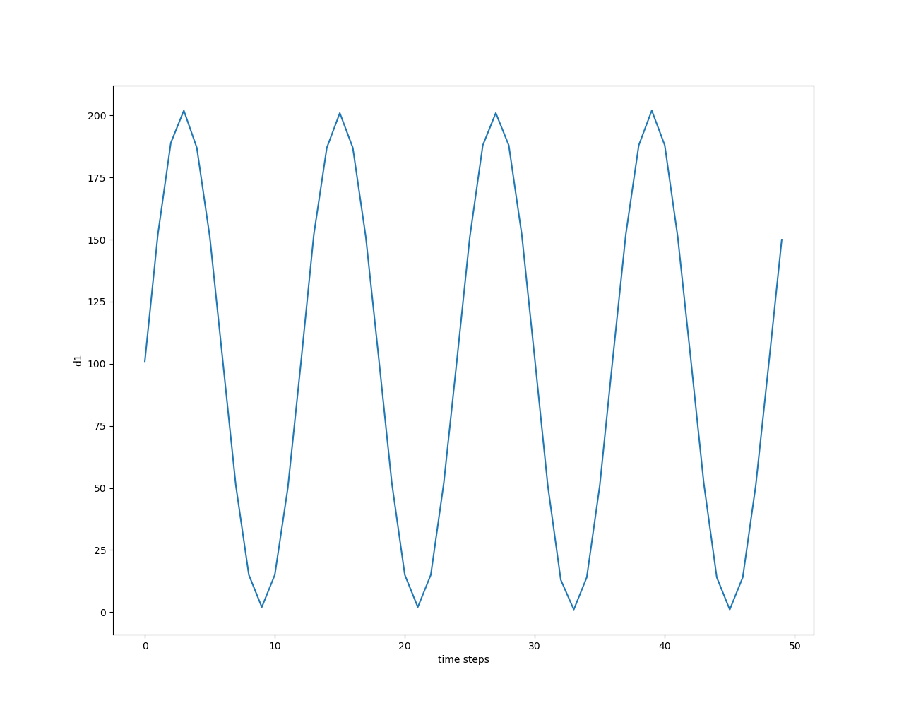

RL Simulation using SAC
Two hidden layers of both actor and critic network with 256 nodes for each layer
A set of parameters is chosen (Georgiadis, Michael C., et al. "Optimal design of supply chain networks under uncertain transient demand variations." Omega 39.3 (2011): 254-272)
$$p=200,k_{pr}=60,k_{st,1}=8, k_{st,0}=8,k_{pe}=40,k_{tr,1}=80,ζ=5,d_{max}=200$$
3e5
Episode Reward
d1
Episode Num

Slide 8
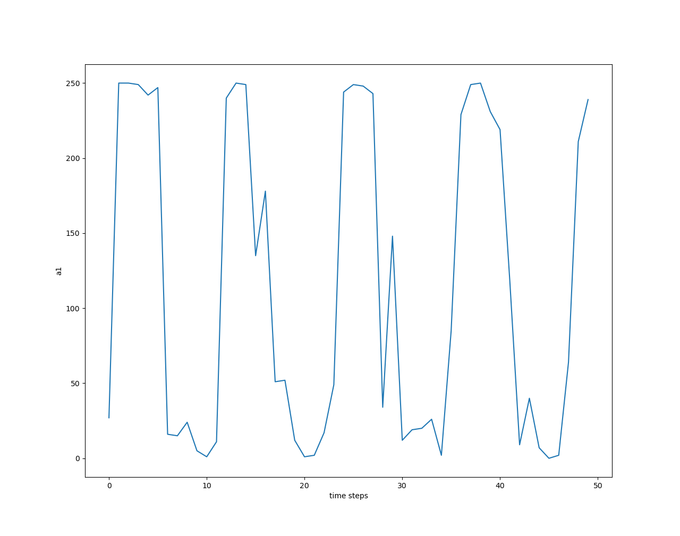
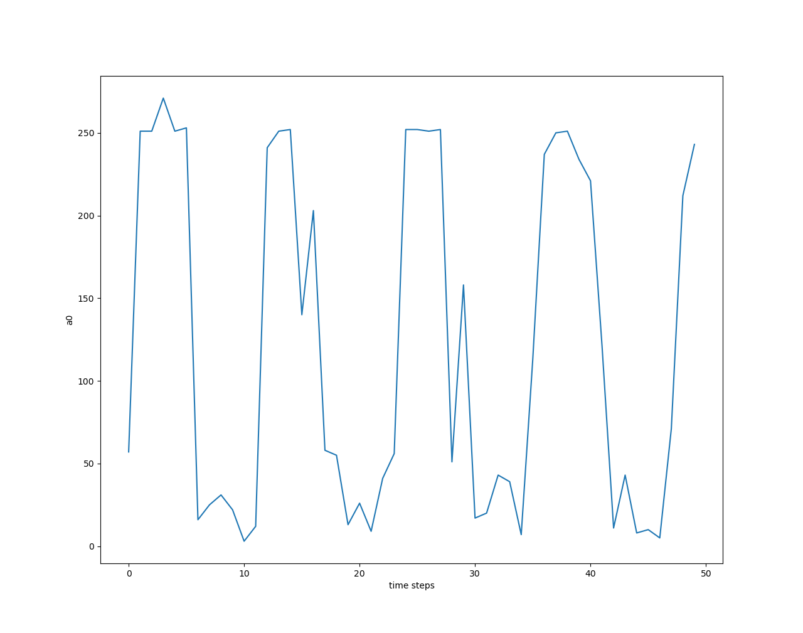
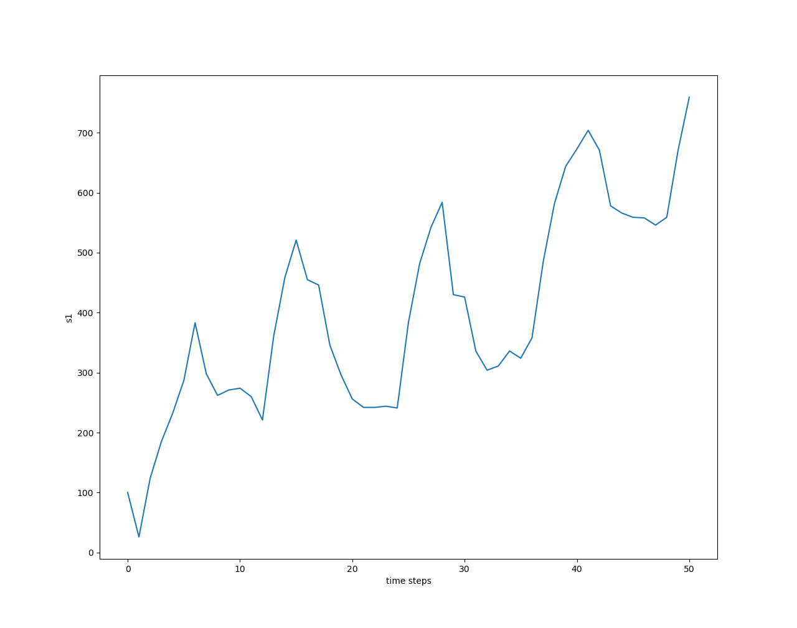
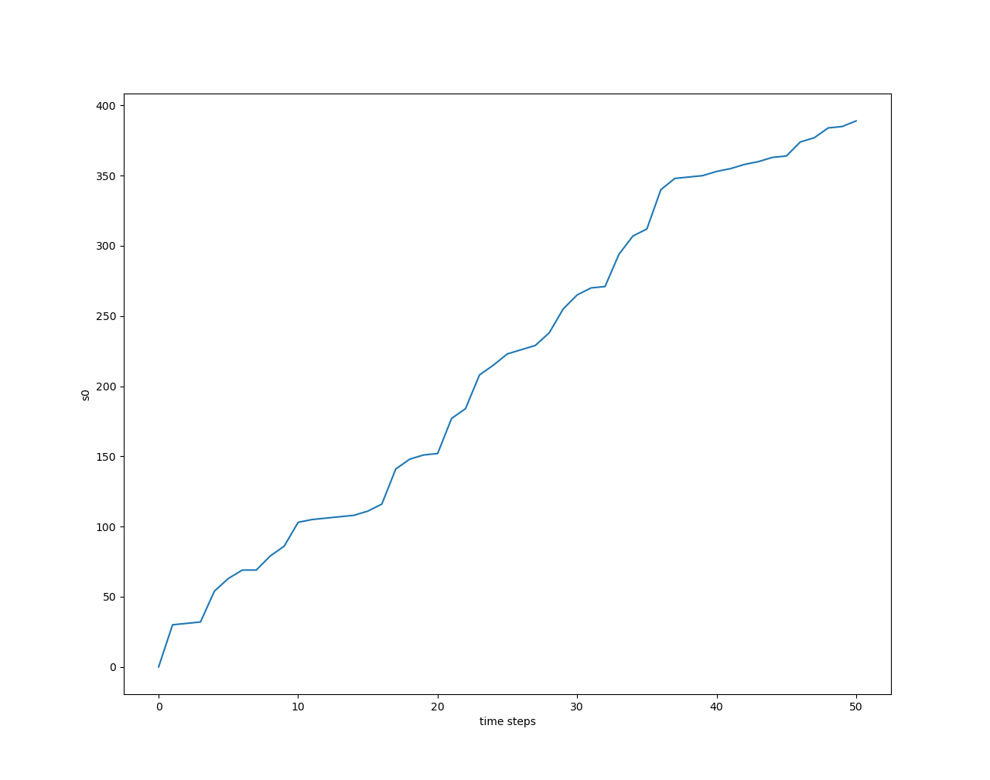
a1
a0
Close to a sinusoidal curve as d1 (ideal case)
s1
s0

Slide 9
Some Thoughts
I also test the same 1 Factory 1 Warehouse problem using (Deep Deterministic Policy Gradient) DDPG, but I am unable to get a good result. The reward will easily fall into local minima. Since DDPG’s exploration strategy is kind of clumsy, it may not handle it well.
Instead, SAC introduce an entropy term with a temperature coefficient. This way it will encourage a better exploration accordingly, and can better resolve this local minima issue.

Slide 10
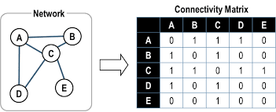
Modular Environment Structure
1. env.make: Setup network structure (num of factory/warehouse, network connection); coefficient for one-step cost/reward
Input: 2D-array of network structure; 2D-array for different reward/cost
2. env.step: 1-step update for the environment
Input: current action
Output: next state; one-step reward value; termination signal
3. env.reset: Initialize/reset the state

